Slide 1
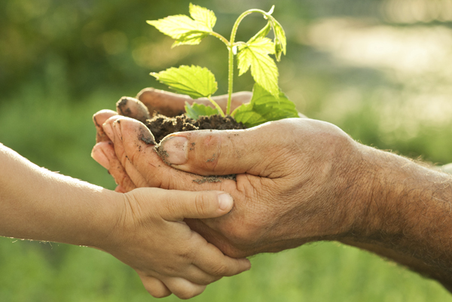
Communication/Language and Literacy
Listening, Attention and Understanding
Children will identify the main characters in the story and talk about their feelings.
Children will ask “where” questions.
Speaking
Children will know and re-tell Farmer Duck
Children will know and use vocabulary linked to their theme ‘Nurturing Nature’ including recycling, environment, and wild plants.
Comprehension
Children will read and re-read a selection of books, developing fluency, understanding and enjoyment.
Word Reading
Children will read and correctly form the sounds ai, ee, igh, ow, oo (short), oo (long)
Children will blend known sounds in words
Children will know tricky words he, she, me, we, be
Writing
Children will know how to correctly form the letters b, f. j, v, w
Children will know how to write a short phrase
Reception Spring 2
What will I be learning this half term?
Reminders
Please ensure all book bags, clothes, coats, PE kits and water bottles are labelled with your child's name.
We look forward to seeing you for Parents Evening this half term- details to follow!
Please make sure to send in water, not squash or juice.
Please remember to check Seesaw for information, updates and photographs of your child’s learning. If you are struggling to log in, please let us know and we can help you!
Personal, Social & Emotional
Self-Regulation
Children will know the effects of their behaviour on others.
Managing Self
Children will know what a sensible amount of screen time is and why this is important for their health.
Building Relationships
Children will be able to describe what makes a good friend including attributes such as listening and sharing.
Understanding the World
Children will know that the past is anything before the current day
Children will know that the present is now
Children will know that we can only grow certain fruits/veg in the U.K.
Children will identify typical weather in Spring
Children will know the name of the 4 seasons and the weather associated with them
Children will know the life cycle of a sunflower
Children will know how to care for a plant
Children will know the Easter story
Children will know how to use laptop to make digital art using programmes like “Paint”
Nurturing Nature
Physical
Gross Motor
Children will know how to play “Follow the Leader” using a variety of traveling movements
Children will attempt to jump rope
Children will know how to bounce and catch a ball
Fine Motor
Children will know how to hold two hole scissors to make snips in paper
Children will know how to correctly form the letters h, b , f, l, j
Maths
Number
Children will add numbers to 10
Children will subtract numbers to 10
Numerical Patterns
Children will learn to halve numbers to 10
Children will learn to double numbers to 10
Expressive Arts & Design
Children will know the nursery rhymes/songs:
I went to the animal fair
The animals went in two by two
Children will experiment with different ways of playing instruments
Children will join in with choreographed dance
Children will know how to use and mix watercolour paints
Children will know how to use different techniques to make 3d collages
Children will know how to make a slot join

